Slide 1
DHS Cloud Service
By: Saketh Lakshmanan, Christian Domacena, Rafael Simioni

Slide 2
Benefits of Cloud Computing
Reduced IT Cost
Most cloud computing services offers Pay-as-you-go structure
No new hardware necessary
Reduce energy cost
Servers and other hardware upgrade or repairs are handled by the vendors.
Eliminates Redundancies
Flexibility
Can handle fluctuating demands
Resolves data-storage issues
Security features
Variety of tool selection that fit a company’s needs
Notes:
Christian

Slide 3
Strategic Value
Teams can collaborate from widespread locations
Competitive Advantage
Automatic Software Updates
Efficiency
Accessible to anyone from anyone with a device connected to the internet
Loss prevention
Speed to market
Notes:
Christian

Slide 4
Risks of Cloud Computing
Confidentiality
Sensitive data are handled and transmitted between two or more parties.
Ownership claim
Compatibility
Change in service
Return on investment
Availability
Service disruption
Notes:
Christian

Slide 5
Cloud Computing Types
Public
Cloud infrastructure available for the all of public over the internet
Owned by cloud service providers
Individual organizations using it do not have private access
Private
Privately owned by a single organization
Can be managed by a third party or the organization itself
Has a data center that is on-premises
Hybrid
Combination of a public and private cloud
Organization has data centers on-premises as well as public clouds to mix and match
Notes:
Writer: Saketh Lakshmanan

Slide 6

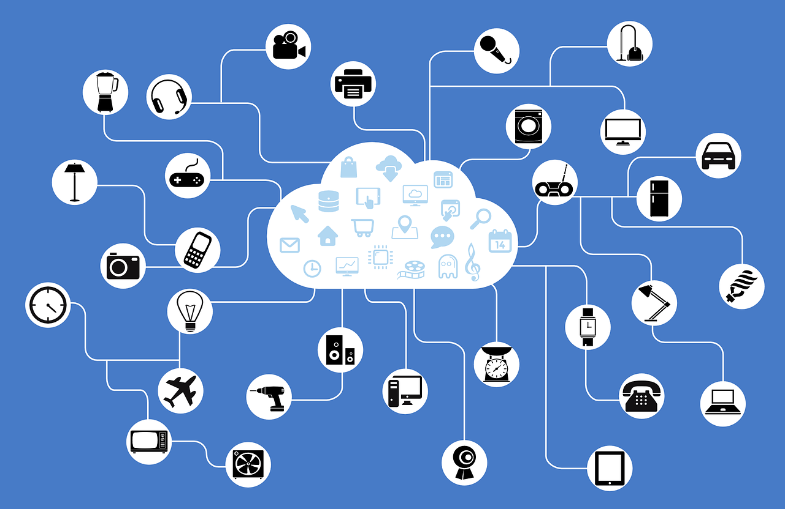
Building Cloud Service at DHS
We are trying to provide public and private cloud offerings, so essentially a hybrid system
Private Cloud offerings
For sensitive but unclassified information
Public Cloud offerings
For non-sensitive information
Notes:
Writer: Saketh Lakshmanan

Slide 7
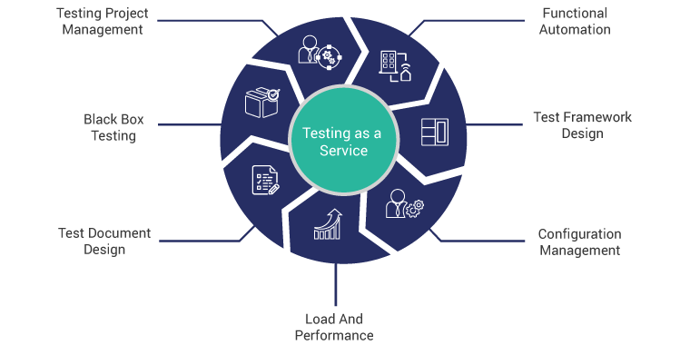
Development and Test as a Service (DTaaS)
Mobility
Increase productivity
Less onboarding time
Fully managed teams

Slide 8

Infrastructure as a Service (IaaS)
Provides storage, backup, and recovery.
High-performance computing
DHS does need to provide maintenance to their hardware. All the troubleshooting and upgrades are handled by the service provider
Disaster Recovery

Slide 9

Email as a Service (EaaS)
Service to ensure the privacy of incoming and outgoing emails sent by or to the Department of Homeland Security
Will be used across Headquarters and Federal Emergency Management Agency (FEMA).
Expected to have at least 100,000 users DHS-wide on this service
Notes:
Writer: Saketh Lakshmanan

Slide 10

SharePoint as a Service (SHPTaaS)
Service to help different organizations across the DHS share online resources easier and more securely
Organizations using it will be the Headquarters and United States Citizenship and Immigration Services
Expected to have at least 90,000 users
Notes:
Writer: Saketh Lakshmanan

Slide 11

Authentication as a Service (AuthaaS)
Fully automated lifecycle administration of users, permissions and tokens
Automated threshold and event-based alerts
No hardware requirements
Various 2FA authentication methods to choose from.
Customizable security policies

Slide 12

Case and Relationship Management as a Service (CRMaaS)
Leverages Enterprise License Agreements (ELA)
Improve case workflows
Better Customer Relationship Management or CRM
Provide regulations tracking service

Slide 13

WorkPlace as a Service (WPaaS)
Enabling a mobile workforce is important
Will provide mobile services for DHS users nationwide like
virtual desktop,
remote access
The expectation is that the service reduces yearly expenditures on traditional desktop and laptops
Notes:
Writer: Saketh Lakshmanan

Slide 14

Project Server as a Service (PSaaS)
A management service to help publish project schedules that can be easily shared across offices and divisions
Improves the standardization of project management
Supports the efforts to improve the management of both IT and non-IT programs
Notes:
Writer: Saketh Lakshmanan

Slide 15

Business Intelligence as a Service (BIaaS)
Offers Data & Model optimization
Deploy analytics tool
Organize and plan dev sprints as needed for progress and scale
Security & Usage Monitoring

Slide 16

Identity Proofing as a Service (IDPaaS)
Provide an extra layer of protection for user accounts
Ensures whoever is logging into the account is actually the user
Can immediately stop most attacks that are especially prevalent in government sectors
Phishing
Social engineering
Credential theft

Slide 17

Enterprise Content Delivery as a Service (ECDaaS)
Caching content as close to the end user as possible
Speeds up and improves the overall experience for the end user
Helps to reduce bottlenecks when serving content
Can use private, isolated infrastructure
Needed for handling sensitive data
Provides extra security where needed
Access control
DDoS protection

Slide 18

Web Content Management as a Service (WCMaaS)
Ability to manage content anywhere
Less configuration time
Hosting and domain management are mostly included in the service.
SEO optimized

Slide 19

Conclusion
Cloud-first is very popular
Offloads tasks such as hardware maintenance resulting in decreased maintenance costs
Easily scalable depending on needs and/or current load for further cost savings
No need to physically provision or deprovision hardware
Move the edge further closer to the end user
Improves overall performance and experience

Slide 20
References
https://www.dhs.gov/news/2011/10/05/testimony-richard-spires-chief-information-officer-house-committee-homeland-security
https://www.ibm.com/cloud/learn/iaas

